Slide 1
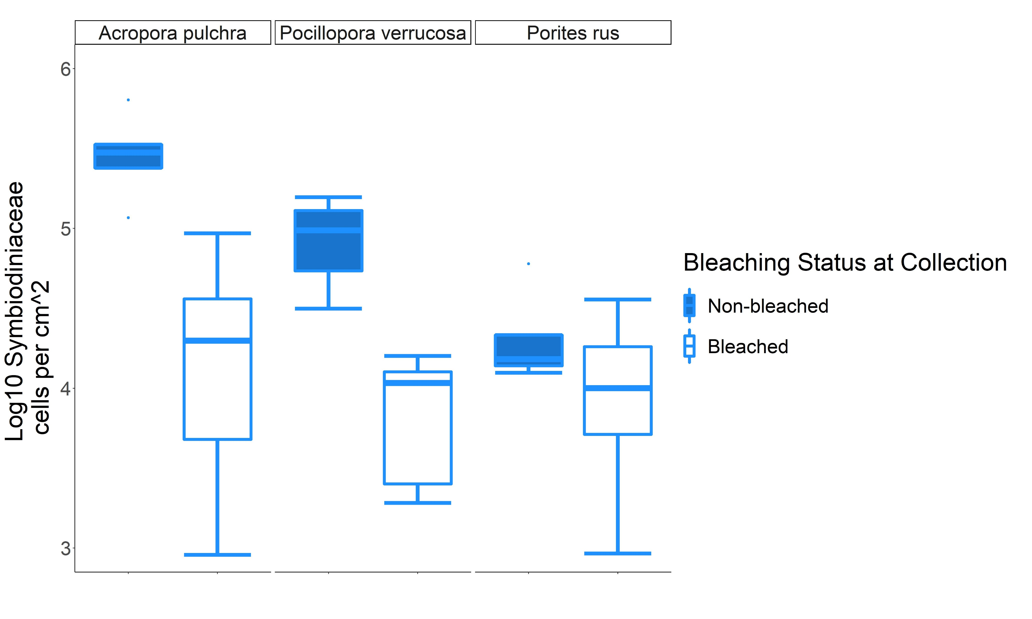
A
A/B
C
B/C
C
C

